Slide 1

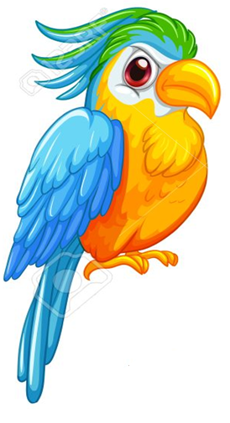
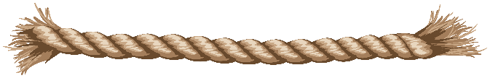

Types of birds

Slide 2
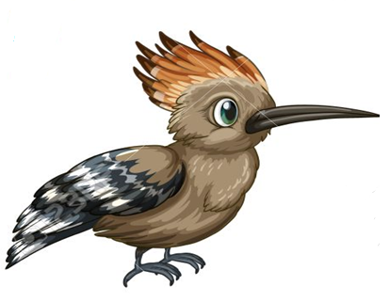
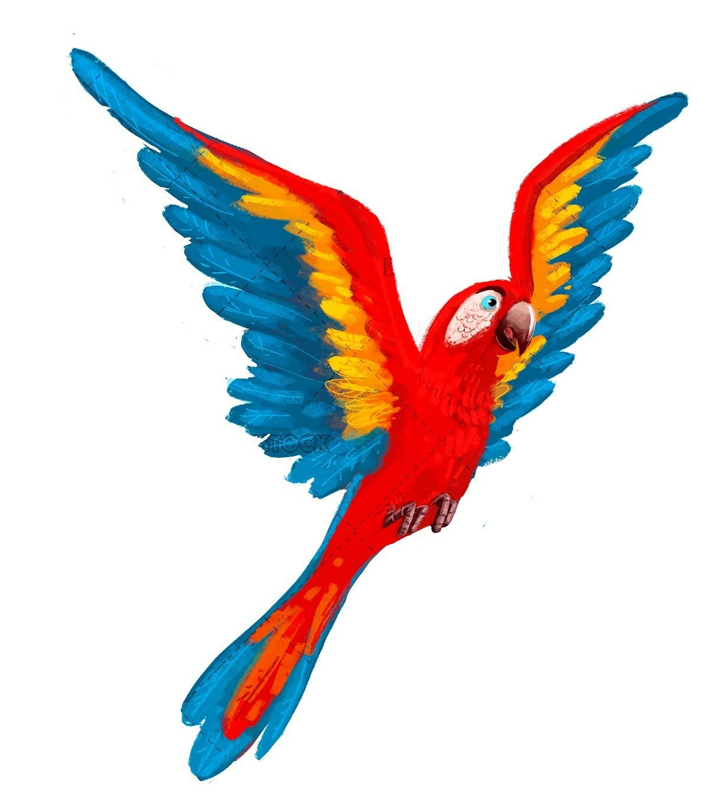
The characteristic that distinguish birds from all other animals is that birds have feathers.
Birds are found in climatic conditions which is extremely hot, cold or dry.

Slide 3
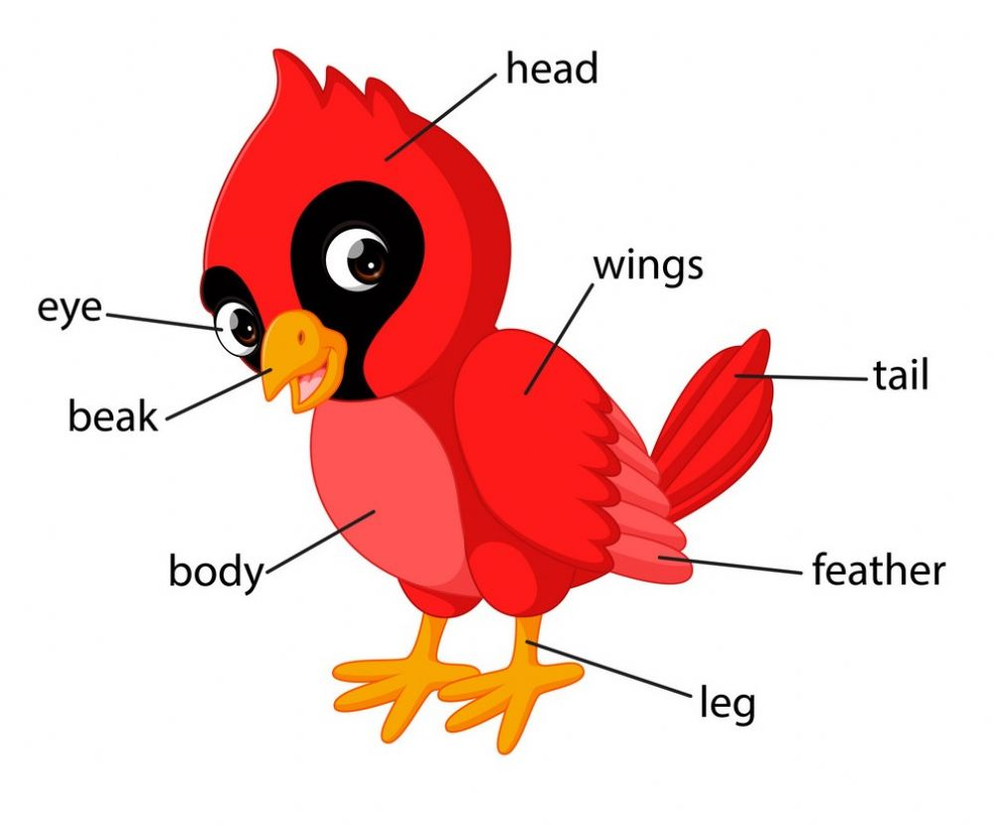
Parts of a bird

Slide 4
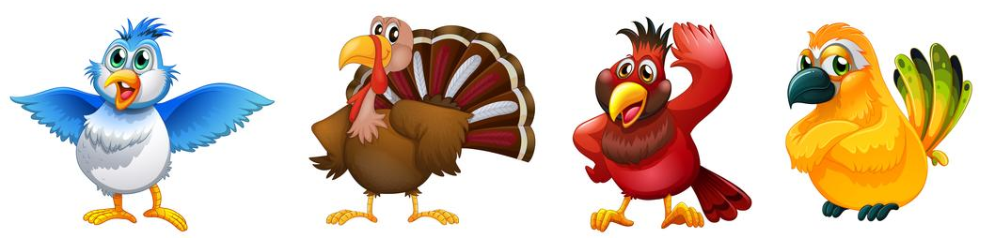
There are five types of birds, each behaves differently from the others , depending on where they live and what kind of food they eat.

Slide 5

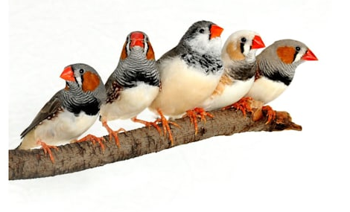
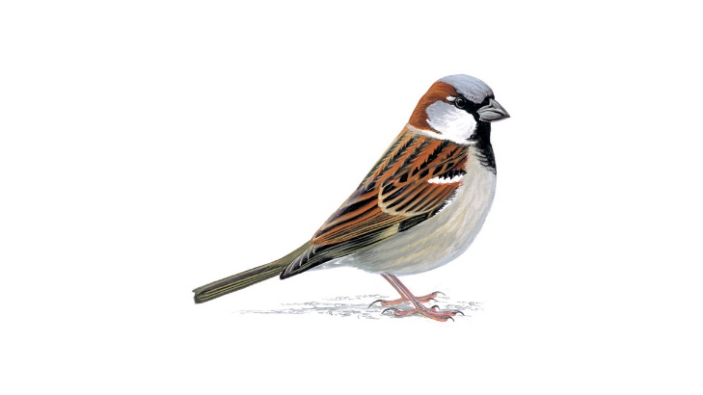
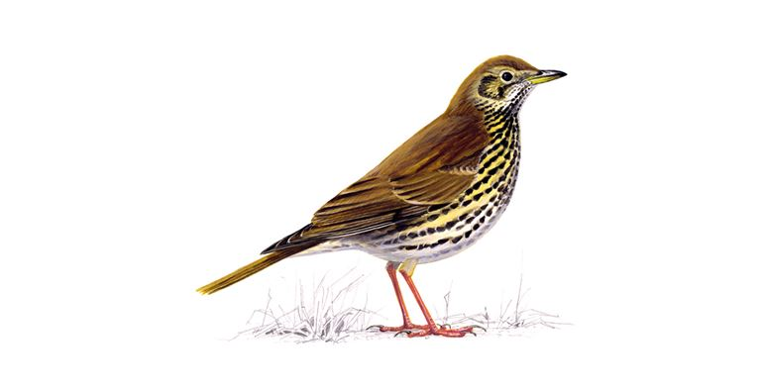
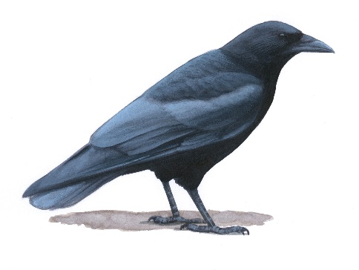
They are most common birds.
They are usually small.
Many have made their homes in cities and towns.
Perching birds
Examples: Sparrows, finches, crow and thrushes

Slide 6
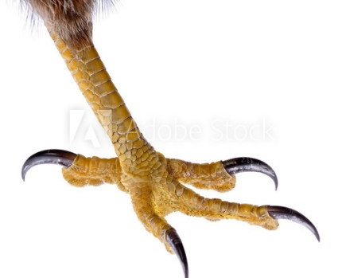
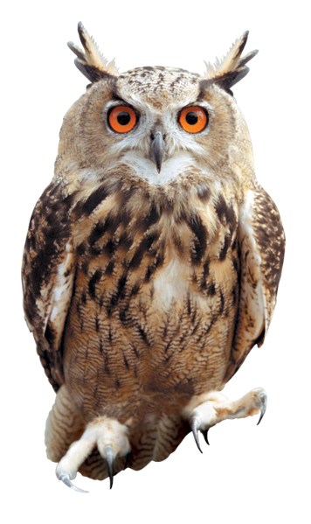
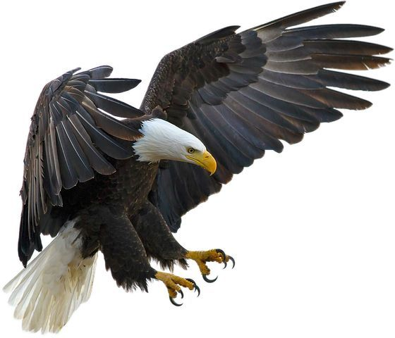
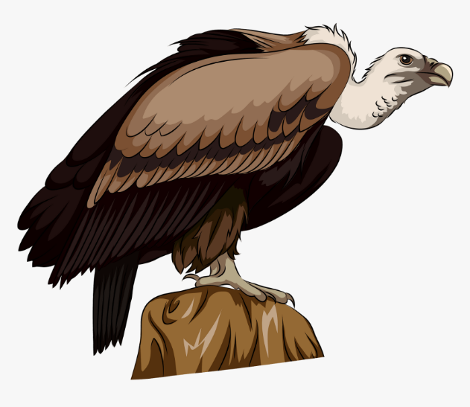
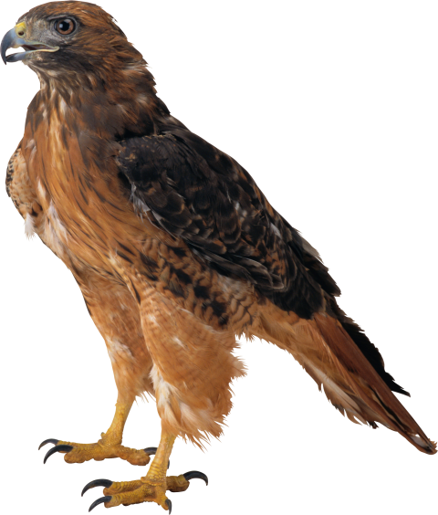
Birds of prey
Skilled hunters
Prey on other animals for food
Excellent eyesight
Strong talons(claw)
Sharp hooked beaks
Examples: hawk, vulture, eagle, owl

Slide 7
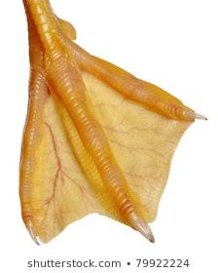
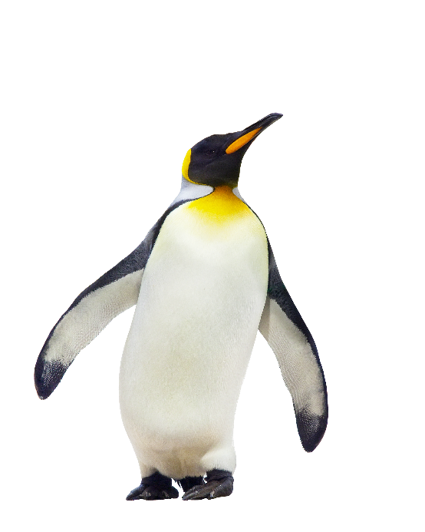
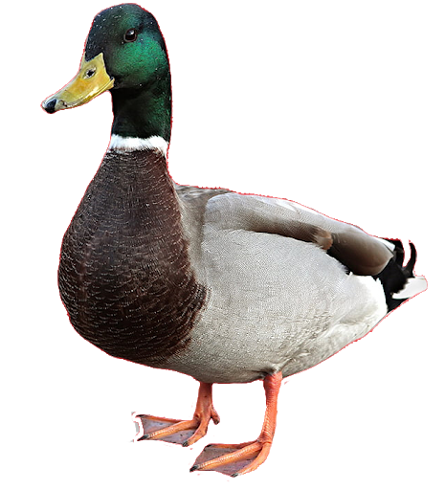
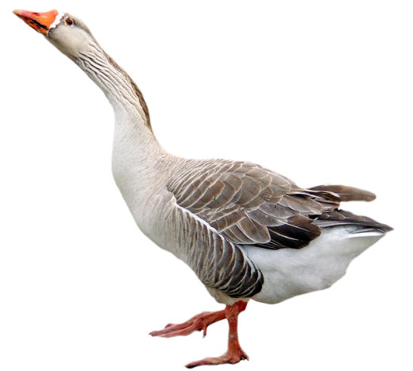
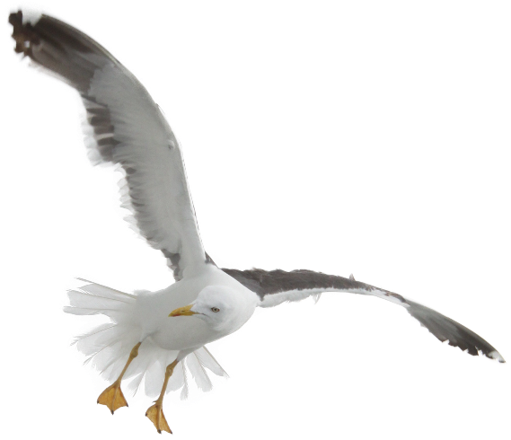
Obtain food from water sources
May have webbed feet for swimming
Aquatic birds
Examples: penguin, duck, goose, pelican gull

Slide 8
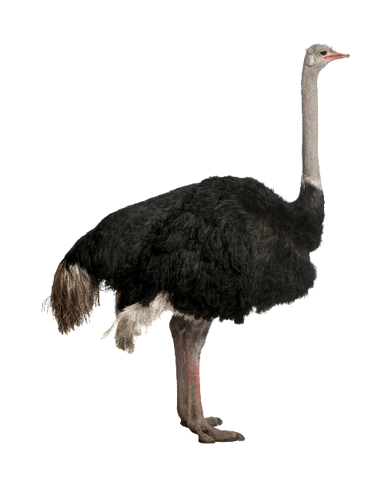
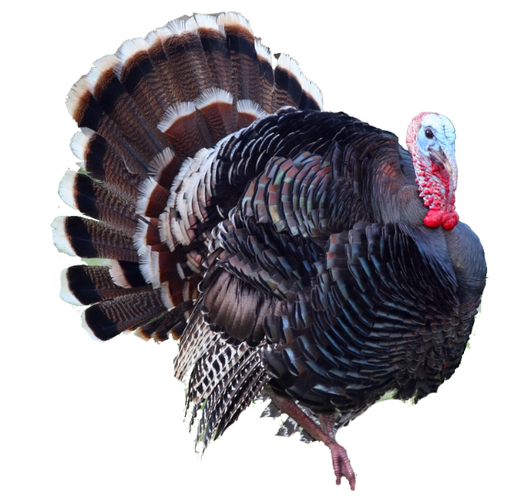
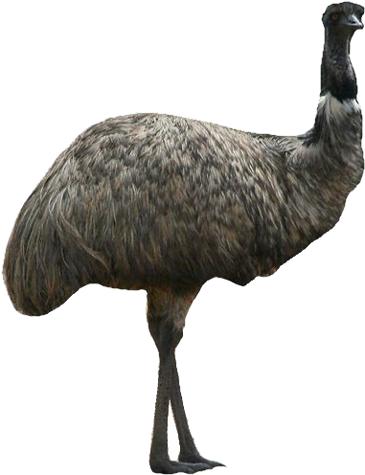
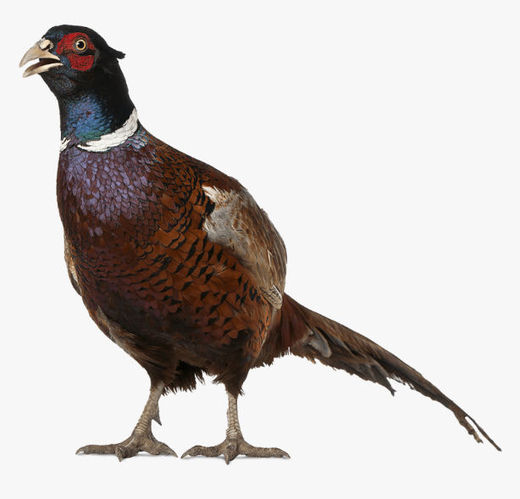
Running birds
Are poor fliers, do not fly
Excellent runners
Obtain food on the ground
Examples: ostrich, emu, turkey, pheasant

Slide 9
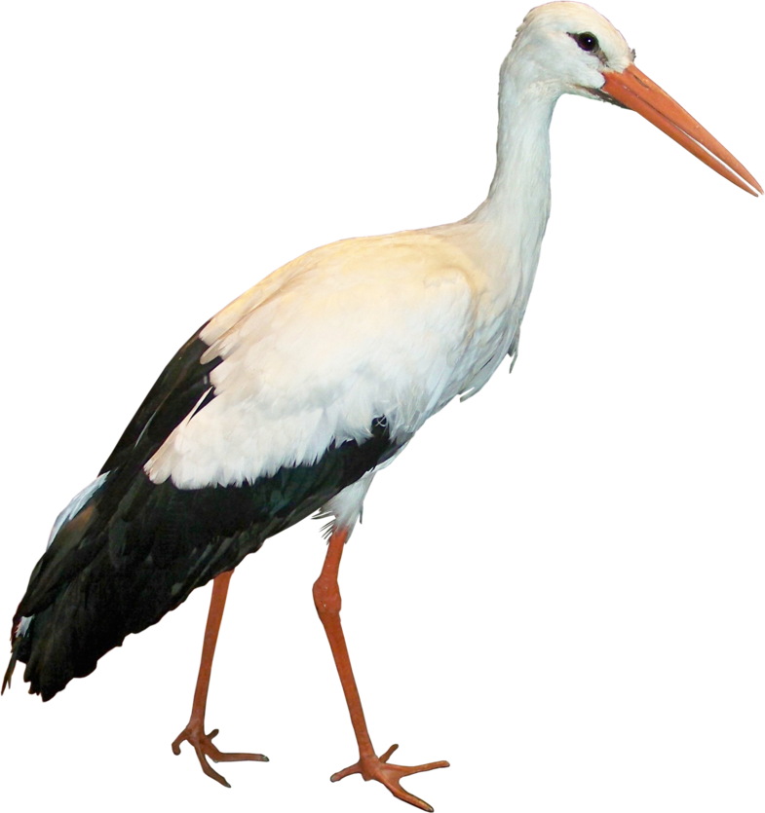
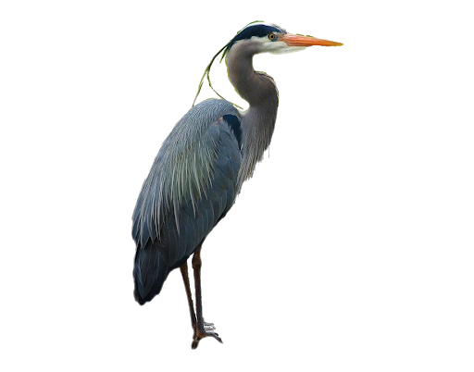
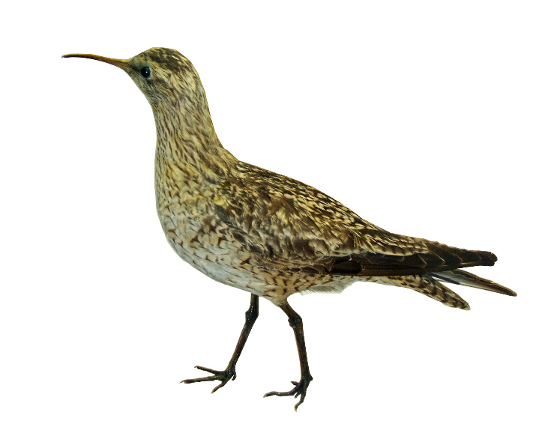
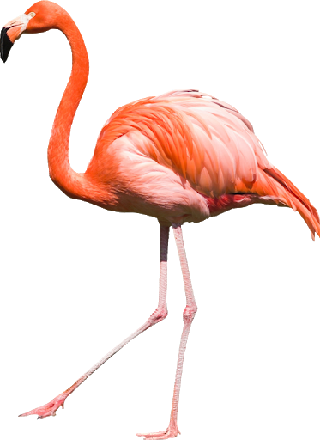

Wading birds
Have bills designed for eating small fish and invertebrates
Generally have long legs for watching some feed on the water surface
Examples: flamingo, stork, heron and curlew

Slide 10

Homework
EVS 2A workbook
Page 41 – Bird word search

